Slide 1
MAIP Assignment
“How safe is My Car?”
SaaS MVP: www.Safercar.com
Date: 06 Nov 2026

Slide 2
Team and Roles
Student Name | Roll Number | Phone Number | Role in Assignment
Naveenchandra.L | 2025MB26078 | 9591810551 | Product Manager
Jerina Jose | 2025MB26077 | 8281813189 | AI Architect/ Manager
Mohanarao Chippada | 2025MB26130 | 8951158816 | Finance Manager

Slide 3
Contents
What is safer car SaaS Application?
Reasons for AI use case?
Possible Users and Customers
Product Architecture
MVP time plan
MVP build cost Analysis
ROI Analysis
Conclusion

Slide 4
What is safer car AI SaaS Application?
Market Opportunity and Problem Statement
The Global Safety Imperative: With over 1.16 million fatalities and up to 50 million injuries reported globally in 2025 (WHO*), automotive safety is a paramount concern and a primary driver for modern car buyers.
Data Fragmentation: Despite the availability of comprehensive crash ratings, this critical safety data is highly decentralized. Prospective buyers face a complex, time-consuming process to aggregate and interpret this information, resulting in market friction and delayed purchasing decisions.
The Solution: safercar.com
safercar.com is an AI-powered SaaS portal designed to eliminate this market friction by centralizing automotive safety data. The platform empowers consumers to make confident, data-driven purchasing decisions while creating a high-intent lead generation pipeline for auto dealerships and insurance providers.
Core Platform Capabilities: Safety & Feature Benchmarking: Delivers intuitive, region-specific, side-by-side comparisons of global vehicle crash ratings, Advanced Driver Assistance Systems (ADAS), and comprehensive vehicle specifications.
Integrated Financial Services: Features a built-in insurance marketplace providing real-time comparisons of policies and premium costs based on the selected vehicle's safety profile.
Streamlined Lead Generation: Drives immediate sales conversions by geographically matching buyers with the closest authorized dealers.
Frictionless Point-of-Sale Connectivity: Integrates direct WhatsApp links to local dealership sales representatives, facilitating rapid quoting, test-drive scheduling, and immediate customer engagement.
* https://www.who.int/news-room/fact-sheets/detail/road-traffic-injuries

Slide 5
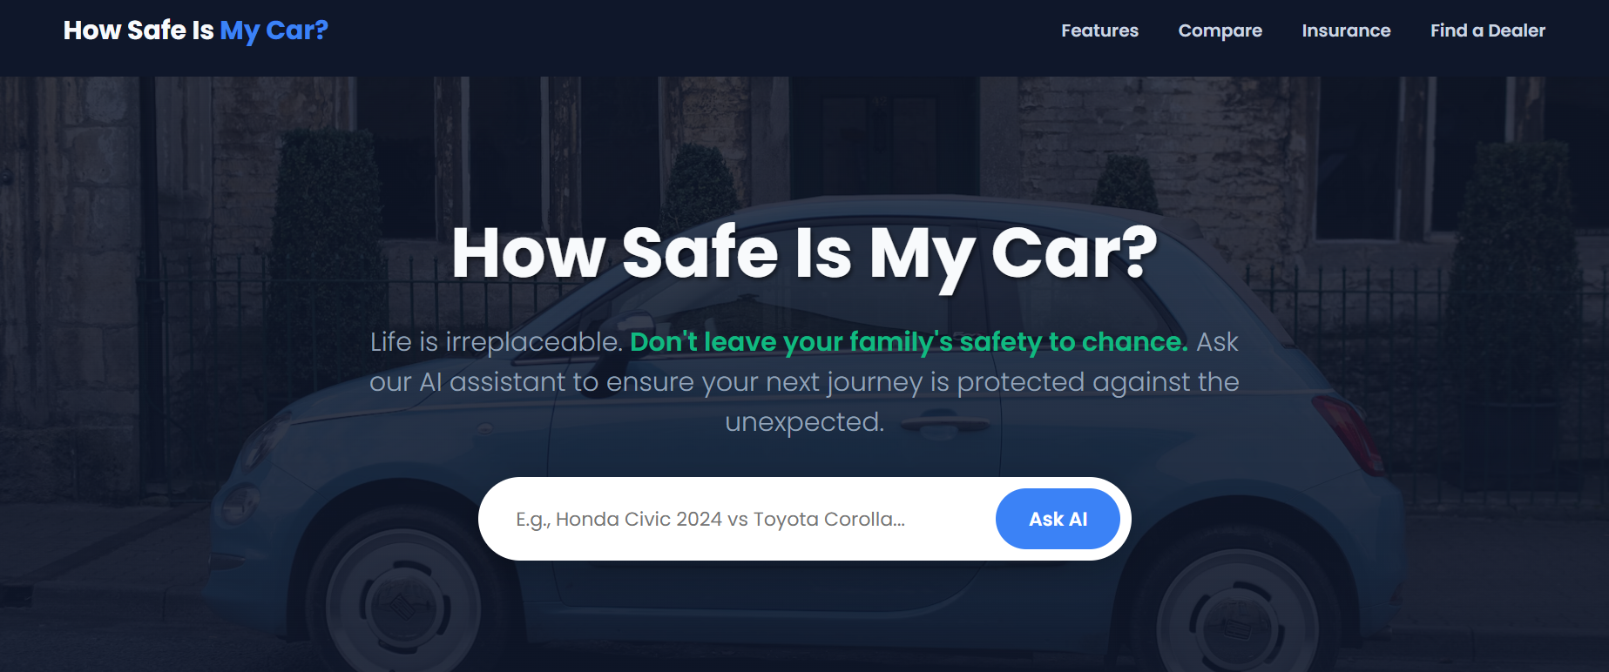
Product Demo Page
www.safercar.com
Link to webpage(double click to open)→

Slide 6
Reasons for AI use case?
Complex Data Landscape: Automotive safety data is highly fragmented, technical, and localized across over a dozen testing bodies like NCAP and NHTSA.
  https://www.euroncap.com/
  https://www.nhtsa.gov/
Consumer Challenges: Everyday buyers often struggle to understand complex engineering reports and regional vehicle variants. It is also difficult for them to assess how different active safety suites translate into real-world protection.
Intelligent Copilot Solution: An AI-driven SaaS platform bridges this knowledge gap by functioning as an intelligent domain copilot. It allows users to interact with complex safety data using intuitive natural-language queries instead of static lookup tables.
Streamlined Evaluations: The platform empowers users to evaluate multifaceted trade-offs in a single seamless conversation. They can easily compare structural metrics between competing vehicles, assess localized insurance implications, and locate certified dealers.
Strong Monetization Potential: Safety is a high-intent purchase driver, enabling a lucrative revenue engine. The platform can generate high-margin B2B revenue via dealer lead generation and insurance referral commissions.

Slide 7
Possible Users and Customers
Users | Customers Targeted
General Public in 40 Countries | OEMs+ Dealers Network Japanese OEMs: Toyota ,Suzuki, Honda, Nissan Chinese OEMs: BYD, SAIC, Geely, China FAW Group Co Ltd, Dongfeng Motor Group Co Ltd Indian OEMs: TATA Motors, Mahindra & Mahindra European OEMs: Volkswagen Group, BMW, Stellantis, Mercedes-Benz Group AG, Renault Group American OEMs: GM, Ford, Tesla, Rivian
Target Countries(40) EU: European Union Countries(27)+UK Americas: USA, Canada, Mexico, Brazil Asia Pacific: India, China, Japan, Thailand, South Korea, Malaysia, Indonesia, Australia | Auto Insurance providers in 40 countries mentioned

Slide 8
Data Sources
Entities | Name | Links
Crash Rating Agency | Global NCAP | https://www.globalncap.org
Crash Rating Agency | Australasian New Car Assessment Program (ANCAP) | https://www.ancap.com.au
Crash Rating Agency | New Car Assessment Programme for Southeast Asia (ASEAN NCAP) | https://www.aseancap.org
Crash Rating Agency | Bharat NCAP | https://www.bncap.in
Crash Rating Agency | China New Car Assessment Programme (C-NCAP) | http://www.c-ncap.org/
Crash Rating Agency | European New Car Assessment Programme (Euro NCAP) | https://www.euroncap.com
Crash Rating Agency | Insurance Institute for Highway Safety (IIHS) | https://www.iihs.org
Crash Rating Agency | Japan New Car Assessment Program (JNCAP) | https://www.nasva.go.jp
Crash Rating Agency | Korean New Car Assessment Program (KNCAP) | https://www.kncap.org
Crash Rating Agency | New Car Assessment Program for Latin America & the Caribbean (Latin NCAP) | https://www.latinncap.com
Crash Rating Agency | National Highway Traffic Safety Administration's New Car Assessment Program (NHTSA) | https://www.nhtsa.gov
Car companies listed in slide 7 | Car companies websites
Dealers of above companies | Dealers network websites/location/contact details
Auto Insurance companies of countries listed in Slide7 | Auto Insurance companies websites

Slide 9
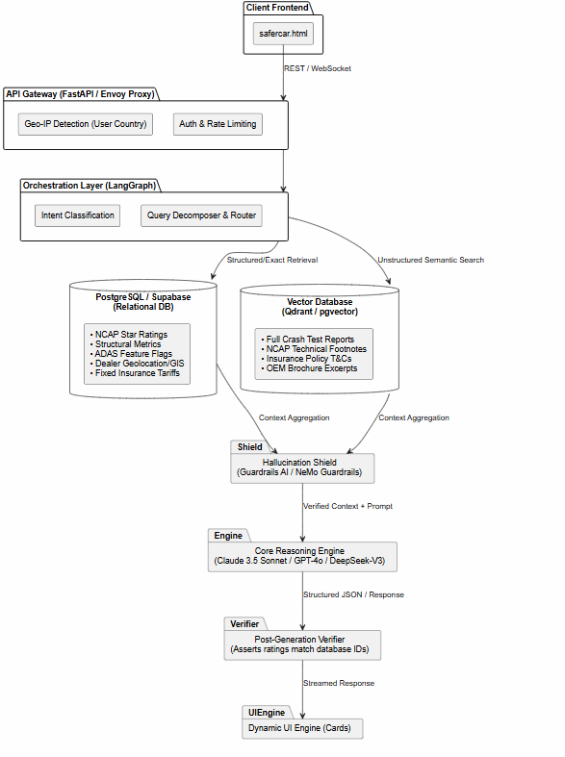
Product Architecture
Detailed AI & System Architecture
To handle unstructured PDF crash sheets, dynamic OEM brochures, insurance matrices, and geospatial dealer lookups across 40 countries, the system requires a Hybrid Agentic RAG + Text-to-SQL Architecture.
Below three primary layers has been identified,
  Data Ingestion & ETL Layer (Multi-Source Pipelines)
  Hybrid Storage Layer
  Agentic Orchestration Layer (LangGraph / LlamaIndex)
Frontend-to-Backend Integration (safercar.html)
Anti-Hallucination & Safety Guardrails
Refer “architecture.uml”

Slide 10
Product Architecture
Data Ingestion & ETL Layer (Multi-Source Pipelines)
NCAP & Regulatory Scrapers: Automated Playwright/Scrapy workers and PDF parsers (LlamaParse / Unstructured.io) scheduled via Apache Airflow to extract structured tables (Adult Occupant, Child Occupant, Pedestrian Safety, Safety Assist scores, bodyshell integrity) from all 11 NCAP/IIHS/NHTSA portals.
OEM & Feature Scrapers: Headless browser agents targeting OEM websites (e.g., auto.mahindra.com) to ingest trim-level specifications, engine metrics, and ADAS feature lists. An LLM-based standardization step maps brand-specific marketing terms into a unified taxonomy (e.g., Level 2 ADAS -> Autonomous Emergency Braking, Lane Keep Assist, Adaptive Cruise Control).
Insurance Engine Ingestion: API connectors and web scrapers targeting insurers (e.g., icicilombard.com) to extract base rates, IDV (Insured Declared Value) depreciation rules, zero-depreciation add-on costs, and safety-feature discounts.
Geospatial Dealer Ingestion: Crawlers extracting dealer addresses, contact numbers, and WhatsApp business endpoints (e.g., mandovi.in), geocoded via Google Maps API into latitude/longitude coordinates

Slide 11
Product Architecture
Hybrid Storage Layer
Relational Database (PostgreSQL + PostGIS): Stores structured vehicle trims, exact numeric crash test scores, insurance premium rate tables, country availability mappings, and geospatial dealer coordinates (PostGIS for nearest-neighbor ST_Distance queries).
Vector Database (Pinecone / Qdrant): Stores chunked, embedded unstructured text from detailed NCAP technical crash commentary, IIHS test notes, and policy terms using dense embeddings (text-embedding-3-large) paired with sparse BM25 vectors for exact model-year matching.
Semantic Cache (Redis): Caches frequent queries (e.g., "Honda Civic 2024 vs Toyota Corolla") to reduce LLM latency and API token costs by 40–60%.

Slide 12
Product Architecture
Agentic Orchestration Layer (LangGraph / LlamaIndex)
When a user submits a query, an Intent Router & Orchestrator Agent decomposes the prompt and invokes specialized deterministic tools in parallel:
Geo-Resolver Middleware: Detects the user's IP/country (across the 40 target countries) and filters the database strictly to car variants and NCAP bodies relevant to that region.
Safety & Spec SQL Tool: Executes deterministic SQL queries to fetch side-by-side numeric crash ratings, ADAS matrices, and general specifications.
RAG Retrieval Tool: Queries the Vector DB with metadata filters (country, make, model, year) to retrieve qualitative crash test findings.
Insurance Calculator Tool: Computes estimated policy premiums based on vehicle ex-showroom price, safety rating discounts, and country-specific coverage tiers.
Dealer Locator & WhatsApp Generator Tool: Queries PostGIS using the user's location to find the closest authorized dealership and constructs an RFC-compliant [https://wa.me/](https://wa.me/) deep link pre-populated with the user's selected car variant.

Slide 13
Product Architecture
Frontend-to-Backend Integration (safercar.html)
The built safercar.html serves as the presentation layer. Below is how each UI component hooks into the backend microservices (built on FastAPI):
Hero Search Box (.search-box input & button):
  Frontend Action: Captures natural language input (e.g., "Honda Civic 2024 vs Toyota Corolla") and triggers an asynchronous POST /api/v1/chat/query request via WebSockets or Server-Sent Events (SSE), passing the query string and browser Geolocation/IP header.
  Backend Action: Streams back a structured JSON payload containing markdown prose alongside structured UI widget schemas (comparison tables, radar charts for safety scores, insurance cards, and dealer CTA buttons) that dynamically render below the .hero section.
Navigation & Feature Cards (#features, #compare, #insurance, #dealers):
  Global Crash Ratings Card: Connects to GET /api/v1/safety/{country}/{make}/{model}, returning localized NCAP star ratings and test year.
  Crash Rating & ADAS / General Feature Comparison Cards (#compare): Connects to POST /api/v1/compare, accepting an array of vehicle_ids and returning a normalized JSON matrix categorizing structural integrity, active ADAS features, and powertrain specs.
  Insurance & Cost Analysis Card (#insurance): Connects to POST /api/v1/insurance/quotes, querying partner tables (like ICICI Lombard) and returning tiered policy cards (Third-Party, Comprehensive, Zero-Dep) with estimated annual premiums.
  Instant Dealer Connect Card (#dealers): Connects to GET

Slide 14
Product Architecture
Anti-Hallucination & Safety Guardrails
Because automotive safety and insurance pricing carry high consumer trust and liability implications, the system enforces a Zero-Hallucination Defence-in-Depth Architecture:
Deterministic Tool-Use Over Free Generation: The LLM is strictly prohibited from using its pre-trained weights to state crash ratings, ADAS availability, or insurance prices. All numeric values and feature booleans (Available / Not Available) are fetched via SQL and injected directly into UI templates; the LLM only synthesizes the surrounding explanatory summary.
Strict Grounding & System Prompt Constraints: Inference runs at Temperature = 0.0. The system prompt enforces a hard fallback rule: "If a specific vehicle trim, crash test score, or regional variant is not explicitly present in the retrieved database context, state 'Official crash test data is not yet available for the [Country] specification of this model.' Never extrapolate Euro NCAP ratings to Bharat NCAP or Latin NCAP models."
Variant & Country Disambiguation Guardrail: Automakers frequently sell cars with identical names but different structural steel grades and airbag counts across regions. If a user asks a broad query (e.g., "How safe is the Hyundai Creta?"), the input guardrail intercepts the query, verifies the user's country via IP, and forces variant/year confirmation before displaying ratings.
Input & Output Guardrails (NeMo Guardrails / Guardrails AI):
  Input Rail: Blocks prompt injections, competitor scraping attempts, and off-topic queries unrelated to automobiles, safety, insurance, or dealerships.
  Output Rail (Hallucination Detection): Runs an automated NLI (Natural Language Inference) faithfulness check comparing every generated claim against the retrieved JSON/RAG chunks before streaming to the user, appending clickable source URLs (e.g., direct links to the bncap.in or euroncap.com PDF report).

Slide 15
MVP time plan
The MVP can be built and launched in 4 Months (16 Weeks) using an agile sprint methodology:
Phase & Milestone | W1–W2 | W3–W4 | W5–W6 | W7–W8 | W9–W10 | W11–W12 | W13–W14 | W15–W16
1. Architecture, DB Schema & UIUX Wireframing | ███
2. Data Pipelines (11 NCAPs + OEM Scrapers) |  | ███ | ███
3. Insurance & Dealer Geo-DB Ingestion |  |  | ███ | ███
4. Core AI Agent, RAG & SQL Tool Building |  |  |  | ███ | ███
5. Anti-Hallucination Guardrails & Eval Suite |  |  |  |  | ███ | ███
6. Frontend (safercar.html) & API Integration |  |  |  |  |  | ███ | ███
7. WhatsApp Lead Flow & Multi-Country Localization |  |  |  |  |  |  | ███
8. Security Audit, Load Testing & MVP Launch |  |  |  |  |  |  |  | ███

Slide 16
MVP build cost Analysis
Usage & Traffic Assumptions (Year 1)
User Base: 20,000 active users spread across 40 countries.
Engagement Volume: Assuming ~15 sessions per user/year and ~5 AI interactions per session = 1,500,000 total AI queries/year (~125,000 queries/month or ~4,100 queries/day).
Cache Hit Ratio: 40% via Redis Semantic Caching, leaving 75,000 net LLM API calls/month.
Token Footprint per Call: ~2,500 input tokens (system prompt + retrieved NCAP/OEM/Insurance JSON context) + ~500 output tokens. Total monthly volume: ~187.5M input tokens and ~37.5M output tokens.
Global passenger car sales in Y2025: 71 Millions
Reasonably assumed 20,000 users(0.03%) as a base condition for MVP

Slide 17
MVP build cost Analysis
Year 1 Cost Breakdown (CapEx + 12-Month OpEx)
Cost Category | Technical Specification | Monthly Cost(USD) | Annual /One time Cost
1. AI Models & Guardrails | Hybrid routing (80% Gemini 2.5 Flash / GPT-4o-mini; 20% Claude 3.5 Sonnet / GPT-4o) + Embedding API + Guardrails | $180 / mo | $2,160 / yr
2. Cloud Hosting & Databases | AWS/GCP (2x ECS/Cloud Run containers, Managed PostgreSQL + PostGIS, Redis Cache, S3 storage, Cloudflare CDN) | $450 / mo | $5,400 / yr
3. Vector DB & Scraping Infra | Qdrant Cloud / Pinecone Starter + Rotating Residential Proxies (BrightData/ScraperAPI) for 40 countries | $320 / mo | $3,840 / yr
4. Third-Party APIs | Google Maps Geocoding API (Dealer search), WhatsApp Business API / Link Routing, Domain & SSL (safercar.com) | $100 / mo | $1,200 / yr
5. MVP Development (CapEx) | 4-Month Lean Pod: 1 Full-Stack/AI Engineer, 1 Data/Scraping Engineer, 1 Frontend Dev, 0.5 QA/PM (India/Offshore rates) | One-Time | $28,000 (One-Time)
6. Annual Maintenance (OpEx) | Scraper selector fixes (when OEMs/NCAPs update UI), quarterly data audits, server patching (Part-time DevOps/Data Eng) | $1,000 / mo | $12,000 / yr

Slide 18
MVP build cost Analysis
MVP Build Cost Summary
Initial MVP Build Cost (CapEx): ~$28,000 (or ~$15,000–$18,000 if leveraging an internal engineering team).
Total Year 1 Operating Cost (AI + Cloud + Scraping + Maintenance OpEx): ~$24,600 / year (~$2,050 / month).
Total Year 1 Investment (CapEx + OpEx): ~$52,600 USD (approx. ₹44–45 Lakhs INR).
Unit Economics: Excluding initial build CapEx, serving 20,000 users costs roughly $1.23 per user per year in total infrastructure, AI tokens, and maintenance.

Slide 19
ROI Analysis(1 Year)
Monetization relies on high-intent qualified leads generated through vehicle safety benchmarking:
Dealer Lead Referrals (Test Drives / Quotes):
  Conversion Rate: 4.0% of users request a dealer connection or test drive quote via the localized WhatsApp / CRM endpoint.
  Payout per Qualified Lead (CPL): $25.00 (standard automotive dealer lead payout across target markets).
Auto Insurance Referrals (Policy Quotes / Click-outs):
  Conversion Rate: 3.5% of users initiate an insurance quote or policy comparison.
  Payout per Qualified Referral (CPA / CPL): $30.00 (auto insurance referral commission).

Slide 20
ROI Analysis (1 Year)
Metric | Calculation | Value (USD)
Dealer Referral Revenue | 20,000×4.0%×$25 | $20,000
Insurance Referral Revenue | 20,000×3.5%×$30 | $21,000
Total Gross Revenue | 20,000+21,000 | $41,000
Variable Cloud / AI OpEx | Slides 17–18 | $12,600
Fixed Maintenance OpEx | Slides 17–18 | $12,000
MVP Build CapEx | One-Time Build | $28,000
Total Year 1 Costs | CapEx + OpEx | $52,600
Year 1 Net Profit / (Loss) | $41,000−$52,600 | -$11,600
Operating Profit (Excl. CapEx) | $41,000−$24,600 | +$16,400
Year 1 ROI | $52,600$41,000−$52,600​×100 | -22.05%

Slide 21
Conclusion
Market Viability: Safercar.com effectively resolves the fragmentation of automotive safety data by providing an AI-driven, hallucination-free portal for consumers across 40 countries.
Robust Architecture: The platform's Hybrid Agentic RAG architecture and strict zero-hallucination guardrails ensure consumers receive highly accurate, localized data regarding crash ratings, ADAS features, and insurance.
Strong Operational Profitability: Despite a Year 1 net loss of $11,600 driven by a $28,000 initial capital expenditure, the unit economics are highly favorable ($1.23 per user annually).
Proven Monetization: The business model validates a positive Year 1 operating profit of $16,400, fueled by high-intent B2B lead generation for dealerships ($25 per lead) and insurance providers ($30 per referral).

Slide 22
Thank You

